Slide 1
Let’s start our project.
For this one, each person should do their own.
For all subsequent ones, all team members will work on the same one.

Slide 2
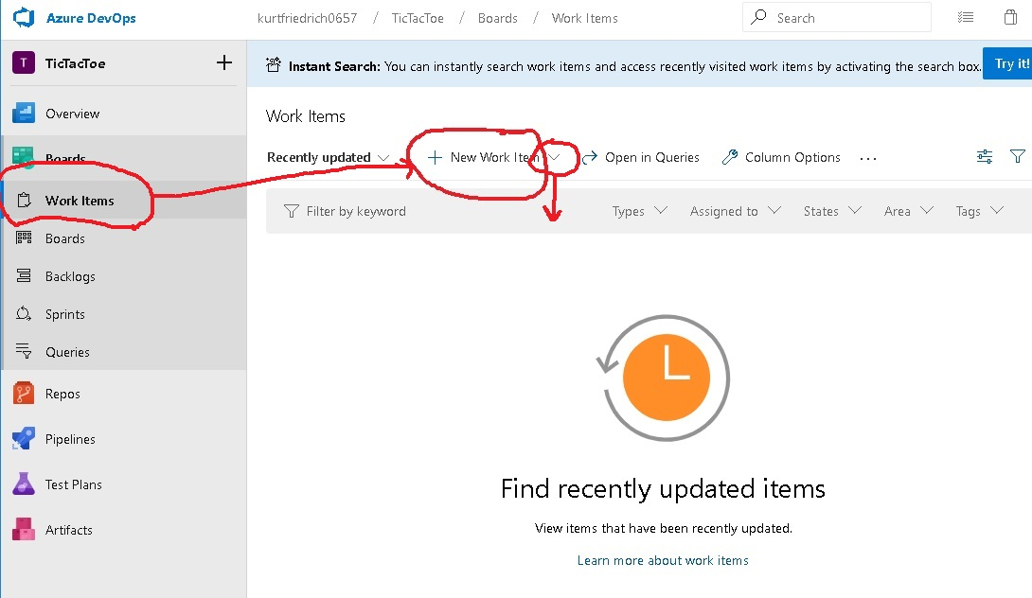

Slide 3
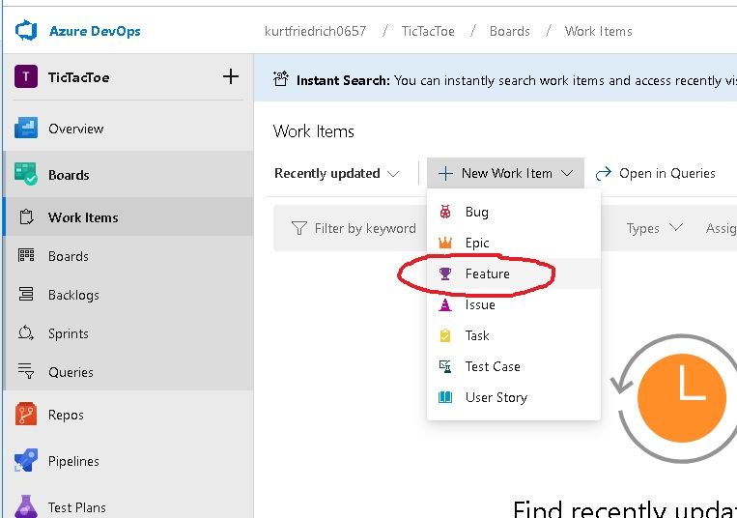

Slide 4
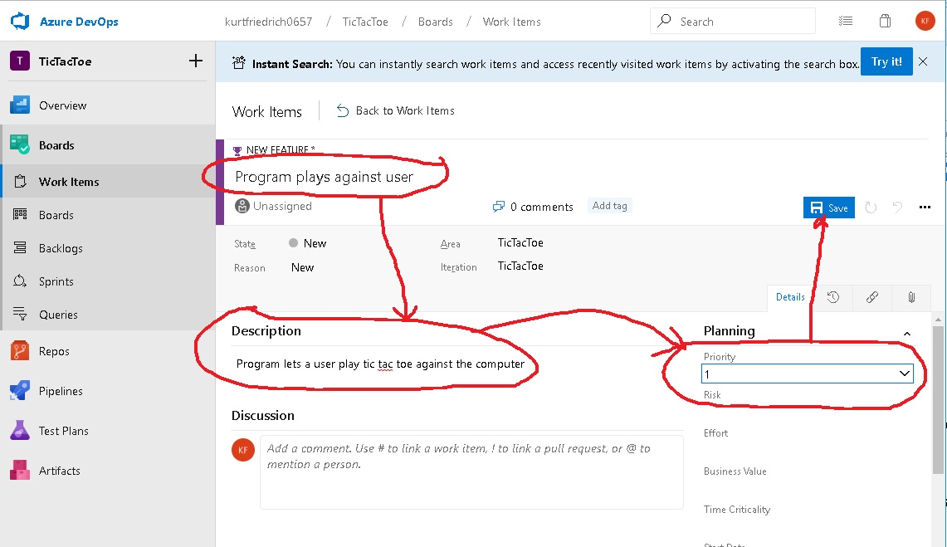

Slide 5
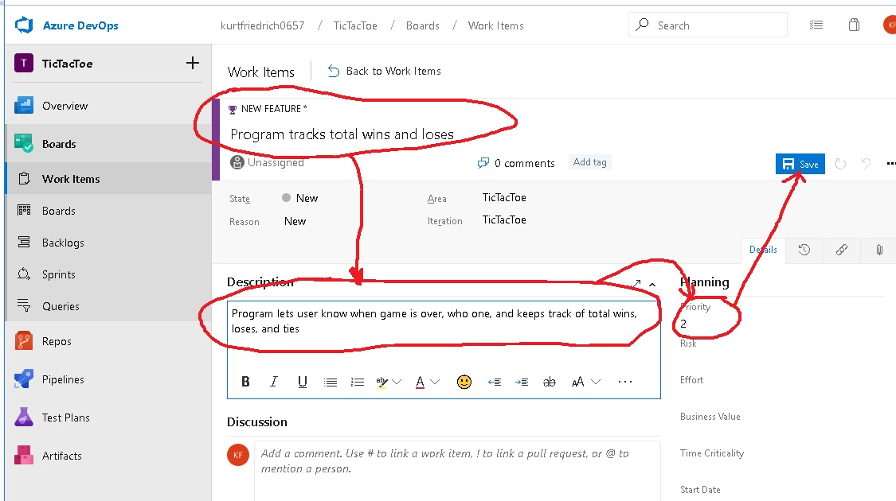

Slide 6
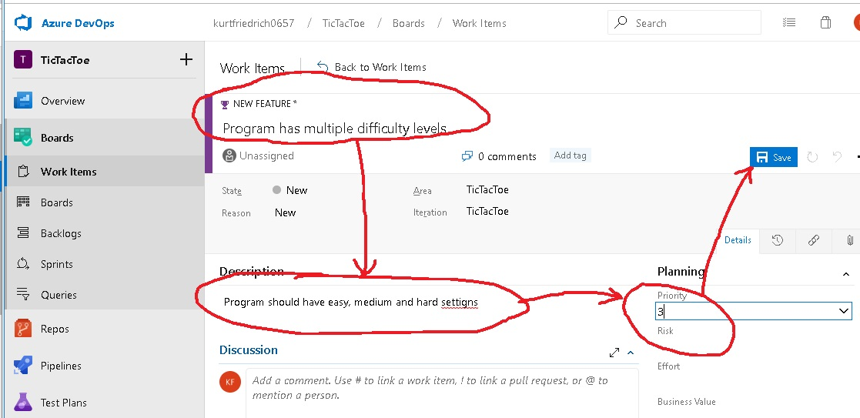

Slide 7
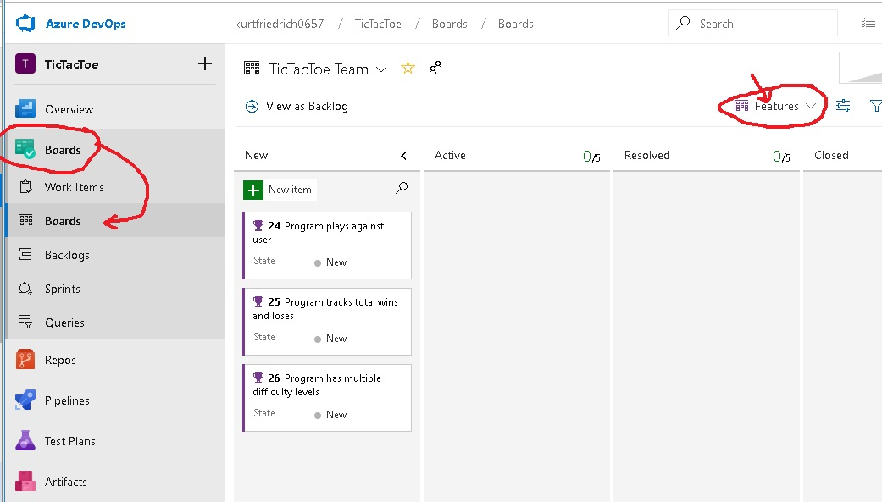
Double click this and edit assigned to prop

Slide 8
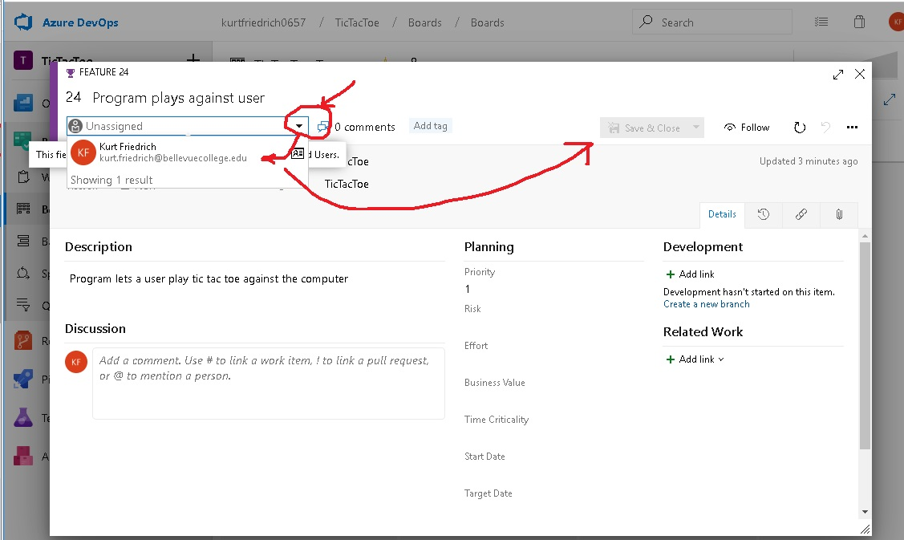

Slide 9
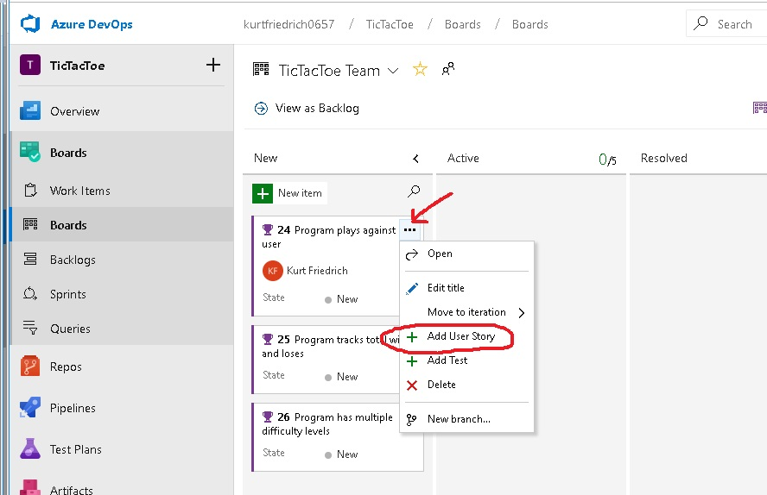

Slide 10
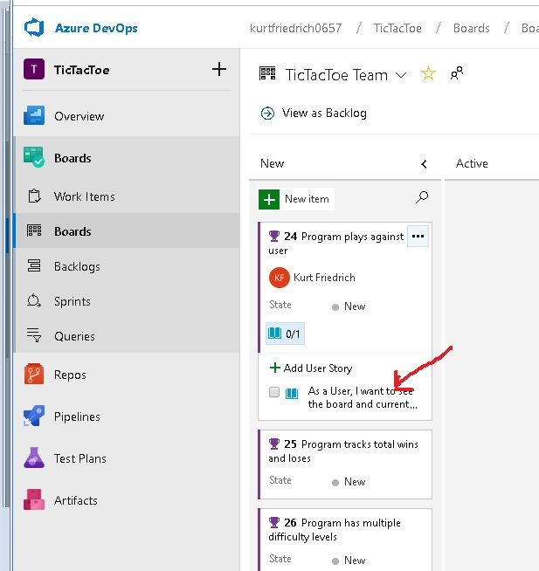

Slide 11
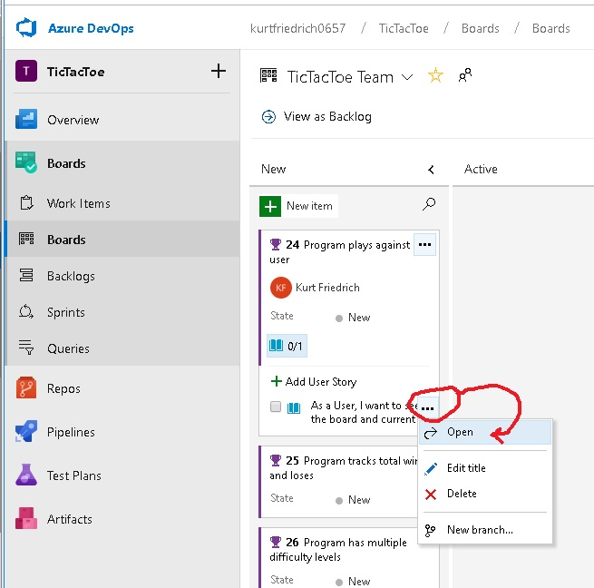

Slide 12
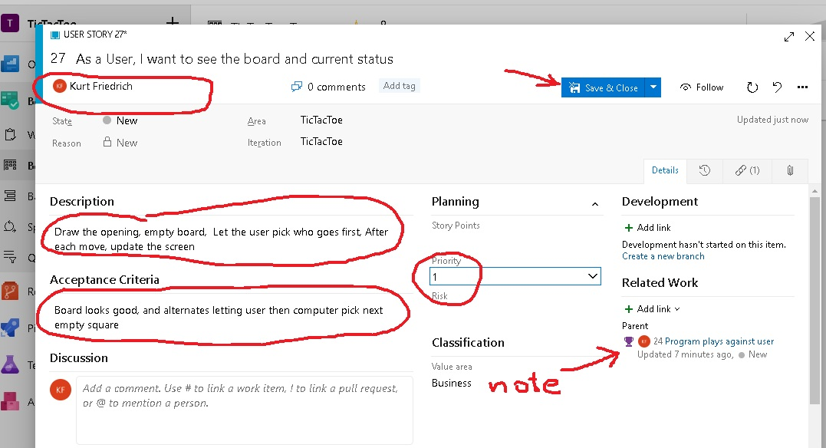

Slide 13
Field | Usage
Effort | Provide a relative estimate of the amount of work required to complete a PBI. For user stories and requirements, you capture estimates in the Story Points and Size fields. Most Agile methods recommend setting estimates for backlog items based on relative size of work. Such methods include powers of 2 (1, 2, 4, 8) and the Fibonacci sequence (1, 2, 3, 5, 8, etc.). You can use any method that works for your team. Use any numeric unit of measurement your team prefers. Some options are story points, time, or other relative numeric value. The estimates you set for Effort, Size, or Story Points are used in calculating team velocity and in forecasting sprints. We will use “hours” and powers of 2 as acceptable values.
Business Value | Specify a priority that captures the relative value of a PBI compared to other PBIs. The higher the number, the greater the business value. Use this field when you want to capture a priority separate from the changeable backlog stack ranking. We will use 1: cannot ship product without it, 2: fundamental requirement of the vision for the V1 product; 3: Very nice to have, 4: Useful, 5: If at all possible, spend time on other items.
Description | Provide enough detail to create shared understanding of scope and to support estimation efforts. Focus on the user, what they want to accomplish, and why. Don't describe how to develop the product. Do provide sufficient details so that your team can break the PBI into tasks and test cases to implement the item.
Acceptance Criteria | Define what "Done" means by describing the criteria that the team should use to verify whether the PBI or the bug fix has been fully implemented. Before work begins on a PBI or bug, describe the criteria for customer acceptance as clearly as possible. Conversations between the team and customers to determine the acceptance criteria help ensure a common understanding within the team to meet customers' expectations. Also, this info provides the basis for acceptance testing.

Slide 14
Your team must fill out those 4 items for each User Story

Slide 15
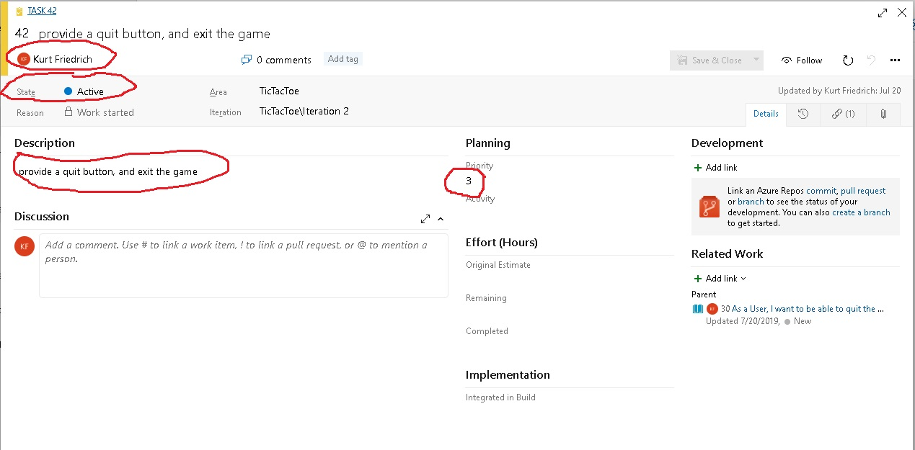
And for Tasks, it must have a description that is clear enough that there is no ambiguity about the functionality to be completed.
Must also have a priority, as it relates to achieving the goal of its parent User Story.
When it is assigned, which it must be at some point, a name should be there.

Slide 16
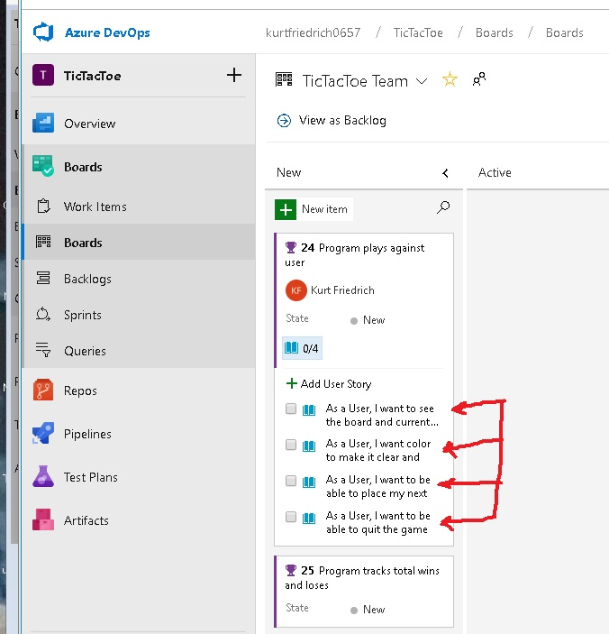

Slide 17
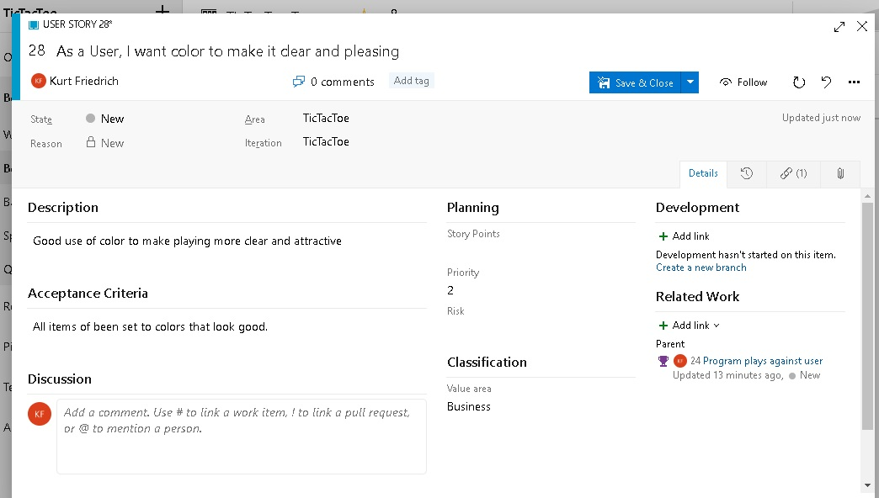

Slide 18
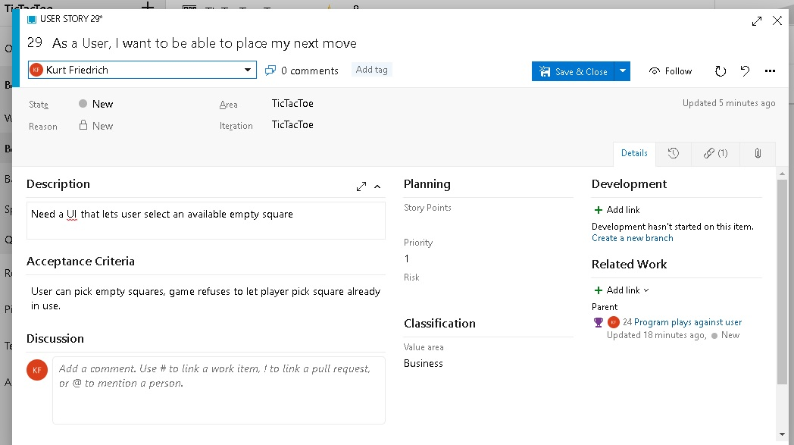

Slide 19
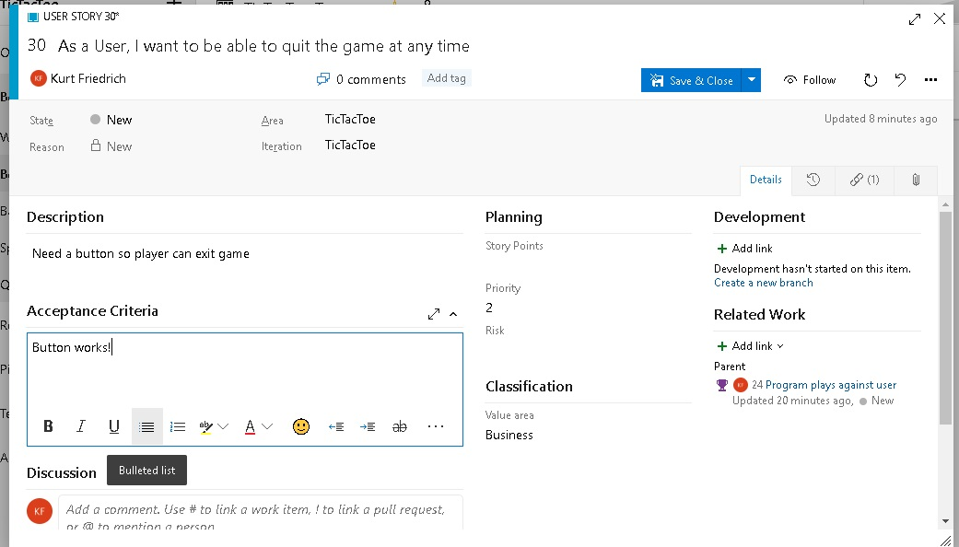

Slide 20
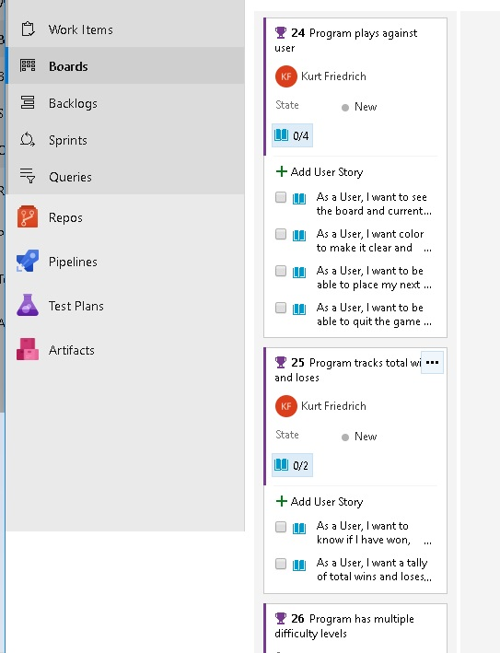
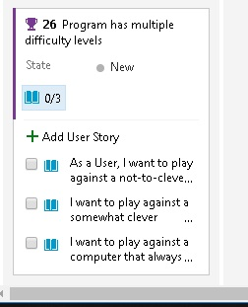
All 3 Features and all their user
stories are entered.
Now break the User Stories down
Into Tasks

Slide 21
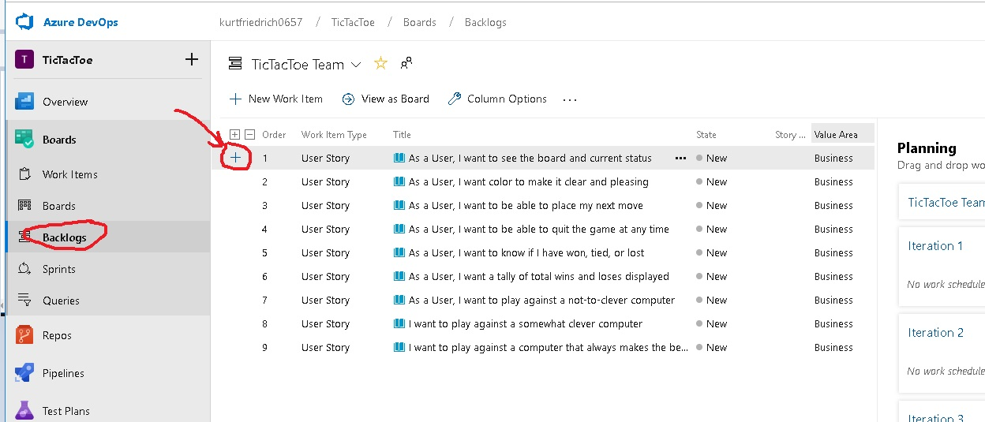
Now click the “+” for each user story and break it done into coding Tasks

Slide 22
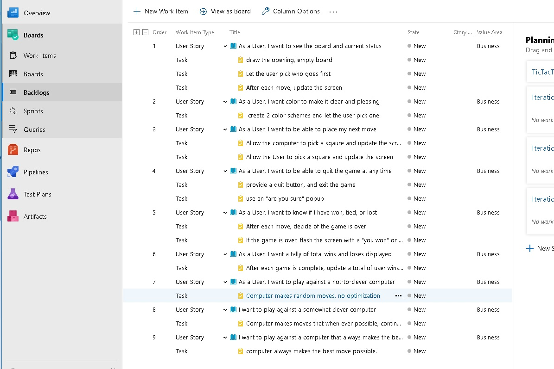

Slide 23
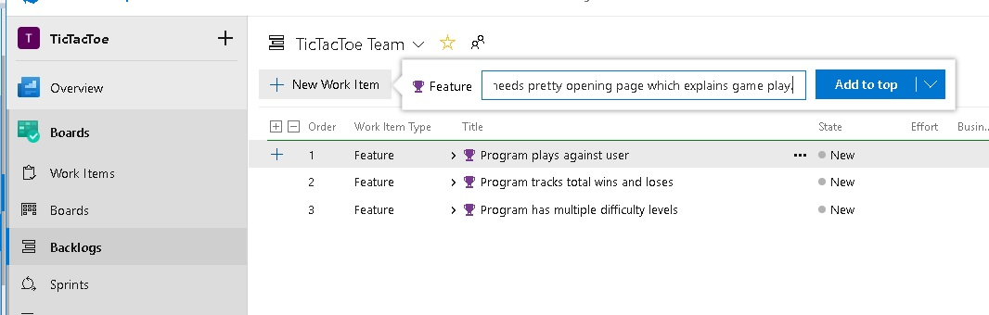
We have now described all the Features, their User Stories, and the Tasks required
to implement them.
Marketing is allowed to come back at any time, and ask for new Features
In fact, they just told me they want an opening screen that explains the game.
So back in and add feature, user stories, tasks

Slide 24
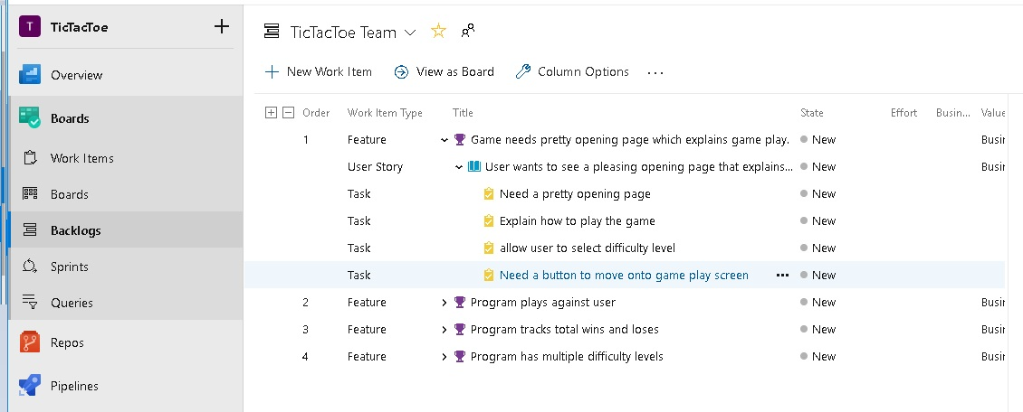

Slide 25
Now it is time to decide what user stories you will complete in the first sprint
Key to this paradigm, “its not done if I can’t see it run”.
So pick items that let you run and show something!

